Slide 1
What is the ‘plastic load’ and carbon footprint of airway management in paediatric anaesthesia in a tertiary paediatric hospital, and can it be reduced?
Dr C Hoddinott, Dr C Watkinson

Slide 2
Introduction
Climate change driven by human activity^{[1]}
Environmental impact of Medicine^{[2]}
“Carbon footprint” – CO2e
Environmental impact of volatile gases^{[3]}

Slide 3
Research objectives
Quantify plastic waste and associated carbon footprint of airway management in paediatric anaesthesia
Identify areas for improvement within normal practice

Slide 4
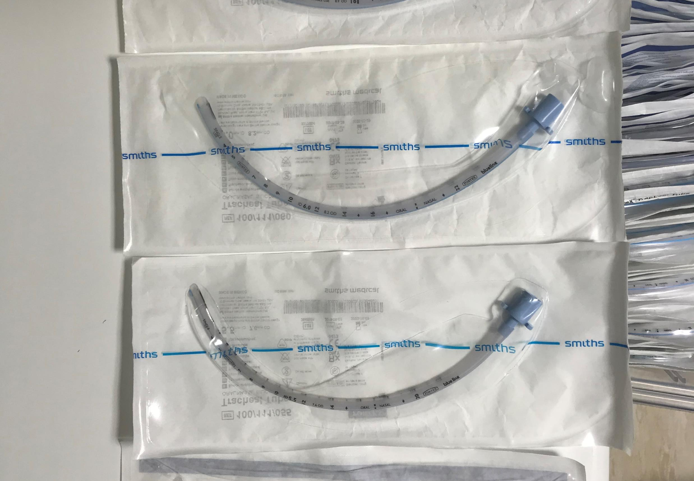
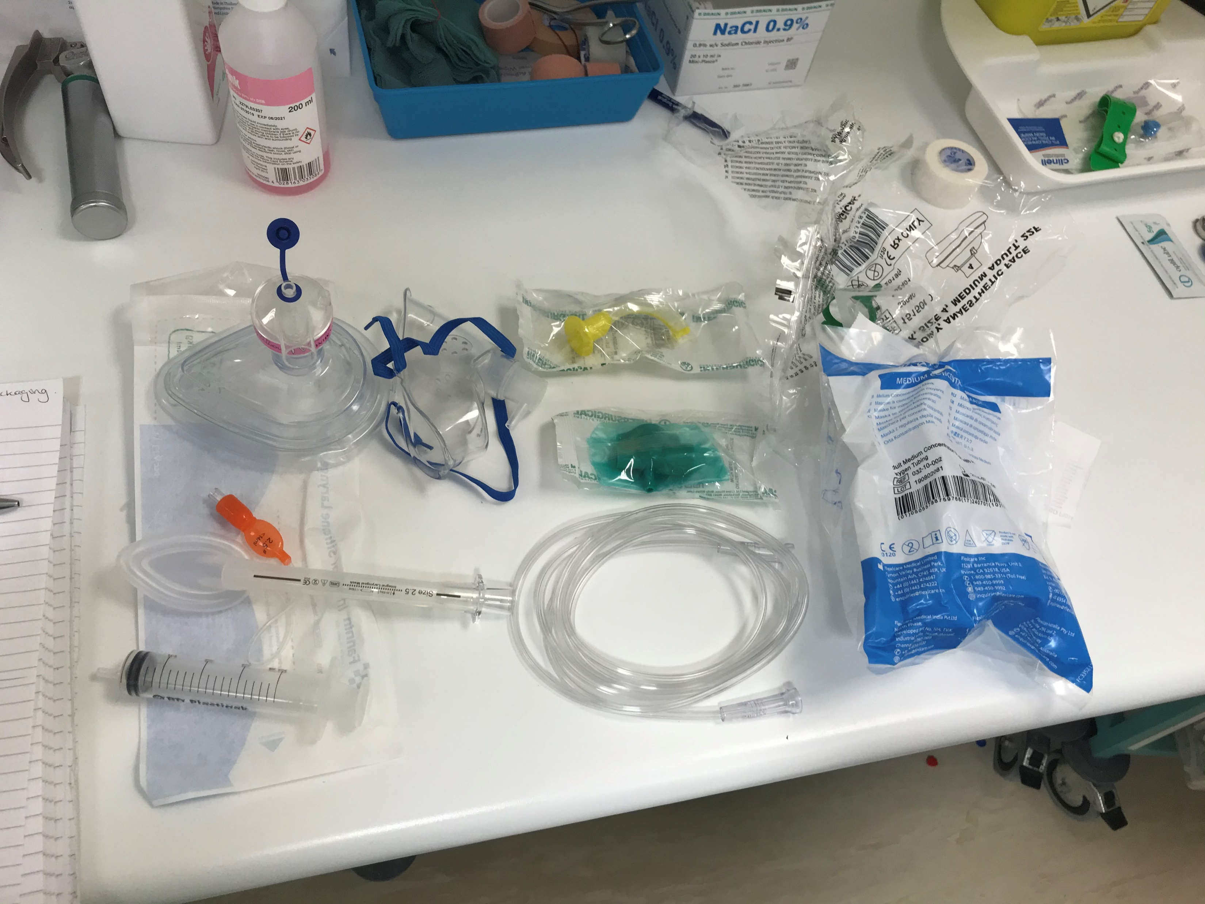
Methods
Random opportunity sample of prepared airway equipment for an 8yr old appendicectomy
Identifying
Allocating essential v optional
Main material
Method of disposal
Weighing
eCO₂ Calculation^{[4]}
MacNeill AJ, Lillywhite R and Brown CJ. The impact of surgery on global climate: a carbon footprinting study of operating theatres in three health systems. The Lancet Planetary Health. 2017 1(9): e381-e388.

Slide 5
Results
Single Use | Weight g | CO2 g |  |  |  | Single Use | Weight g | CO2
Essential |  | Production | Disposal | Total |  | Optional |  | Production | Disposal | Total
CW (Cuffed) | 151 | 480.029 | 178.029 | 658.058 |  | CW | 232 | 737.528 | 273.528 | 1011.056
CW (Uncuffed) | 161 | 511.819 | 189.819 | 701.638 |  | R | 8 | 25.432 | -2.256 | 23.176
CW (LMA) | 165 | 524.535 | 194.535 | 719.07 |  | P | 8 | 25.432 | -2.256 | 23.176
 |  |  |  |  |  | PP | 0 | 0 | 0 | 0
R (Cuffed) | 13 | 38.1155 | -3.603 | 34.5125 |  | CB | 0 | 0 | 0 | 0
P | 10 | 31.79 | -2.82 | 28.97 |  | Total | 240 | 762.96 | 271.272 | 1034.232
PP | 3 | 6.3255 | -0.783 | 5.5425
R (Uncuffed) | 13 | 34.904 | -5.27591 | 29.62809
P | 7 | 22.253 | -1.974 | 20.279 |  | Multi Use
PP | 6 | 12.651 | -3.30191 | 9.349089 |  | CW | 420 | 1335.18 | 495.18 | 1830.36
R (LMA) | 15 | 44.441 | -4.386 | 40.055 |  | R | 45 | 117.363 | -12.186 | 105.177
P | 10 | 31.79 | -2.82 | 28.97 |  | P | 33 | 104.907 | -9.306 | 95.601
PP | 6 | 12.651 | -1.566 | 11.085 |  | PP | 0 | 0 | 0 | 0
 |  |  |  |  |  | CB | 12 | 12.456 | -2.88 | 9.576
BB (Cuffed) | 5 | 16.27 | 9.165 | 25.435 |  | Total | 465 | 1452.543 | 482.994 | 1935.537
BB (LMA) | 16 | 52.064 | 95.43331 | 147.4973
Total |  |  |  |  |  | Estimates | Plastic g | CO2 g
Cuffed | 169 | 534.4145 | 183.591 | 718.0055 |  | Lowest | 169 | 718.0055
Uncuffed | 174 | 546.723 | 184.5431 | 731.2661 |  | Highest | 885 | 3728.894
LMA | 180 | 568.976 | 190.149 | 759.125
CW – Clinical Waste
R – Recycled
BB – Biobin
P – Plastic
PP – Plastic and Paper

Slide 6
Key Results
Single Use | Weight g | CO2 g |  |  |  | Single Use | Weight g | CO2
Essential |  | Production | Disposal | Total |  | Optional |  | Production | Disposal | Total
CW (Cuffed) | 151 | 480.029 | 178.029 | 658.058 |  | CW | 232 | 737.528 | 273.528 | 1011.056
CW (Uncuffed) | 161 | 511.819 | 189.819 | 701.638 |  | R | 8 | 25.432 | -2.256 | 23.176
CW (LMA) | 165 | 524.535 | 194.535 | 719.07 |  | P | 8 | 25.432 | -2.256 | 23.176
 |  |  |  |  |  | PP | 0 | 0 | 0 | 0
R (Cuffed) | 13 | 38.1155 | -3.603 | 34.5125 |  | CB | 0 | 0 | 0 | 0
P | 10 | 31.79 | -2.82 | 28.97 |  | Total | 240 | 762.96 | 271.272 | 1034.232
PP | 3 | 6.3255 | -0.783 | 5.5425
R (Uncuffed) | 13 | 34.904 | -5.27591 | 29.62809
P | 7 | 22.253 | -1.974 | 20.279 |  | Multi Use
PP | 6 | 12.651 | -3.30191 | 9.349089 |  | CW | 420 | 1335.18 | 495.18 | 1830.36
R (LMA) | 15 | 44.441 | -4.386 | 40.055 |  | R | 45 | 117.363 | -12.186 | 105.177
P | 10 | 31.79 | -2.82 | 28.97 |  | P | 33 | 104.907 | -9.306 | 95.601
PP | 6 | 12.651 | -1.566 | 11.085 |  | PP | 0 | 0 | 0 | 0
 |  |  |  |  |  | CB | 12 | 12.456 | -2.88 | 9.576
BB (Cuffed) | 5 | 16.27 | 9.165 | 25.435 |  | Total | 465 | 1452.543 | 482.994 | 1935.537
BB (LMA) | 16 | 52.064 | 95.43331 | 147.4973
Total |  |  |  |  |  | Estimates | Plastic g | CO2 g
Cuffed | 169 | 534.4145 | 183.591 | 718.0055 |  | Lowest | 169 | 718.0055
Uncuffed | 174 | 546.723 | 184.5431 | 731.2661 |  | Highest | 885 | 3728.894
LMA | 180 | 568.976 | 190.149 | 759.125
CW – Clinical Waste
R – Recycled
BB – Biobin
P – Plastic
PP – Plastic and Paper
Notes:
Optional such as suction and Guedel airway. Multi use such as ayres T piece and the circle and it’s reservoir and extension.

Slide 7
Conclusions – Plastic Load and Carbon Footprint
Airway management in paediatric anaesthesia generates:
c.0.2-0.8kg of waste and c.0.8-3.7kg of CO₂ per patient
107.8g CO₂/km average 2020 new petrol car^{[5]}
c.7-34km in average petrol car
This department sees c.12,000 patients per year
At least, 0% NUTH waste goes to landfill
Notes:
EEA – European Environmental Agency - https://www.hps.scot.nhs.uk/publications/hps-weekly-report/volume-55/issue-27/eea-reports-decrease-in-co2-emissions-of-new-cars-in-2020/

Slide 8
Conclusions – Opportunities for Change
A cuffed ETT is the most efficient option
Weight
Sizing error
Reduced volatile gas leak^{[6]}
Appropriate waste disposal – Biobins for syringes
No clear disposal for this syringe
Recycling streams not ideal for syringes as often removed for fear of contamination
But Biobin disposal has highest associated CO₂ and cost
Additional Hudson facemask for transport to recovery
Often goes unused especially in low-risk patients
With the correct attachment you could reuse the anaesthetic mask used for induction

Slide 9
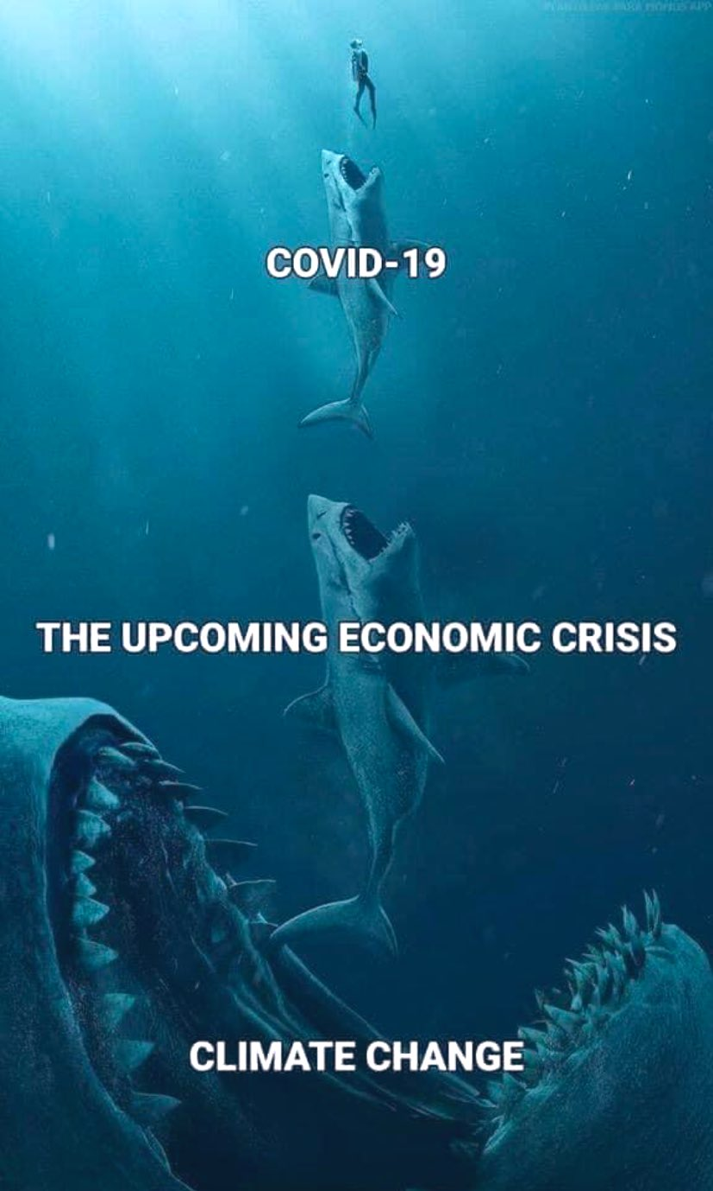
Impact – (Covid)
Recommendations not implemented
Changes in practice since Covid
-ve: 2x plastic aprons + face masks + gloves
Unknown: 2x plastic aprons + FFP3s + gloves
+ve: 2x long sleeve aprons + FFP3s + gloves
New waste streams
MORE PLASTIC!

Slide 10
References
[1] - McMichael AJ, Campbell-Lendrum D, Kovats S, Edwards S, Wilkinson P, Wilson T, Nicholls R, Hales S, Tanser F, Le Sueur D and Schlesinger M. Global Climate Change. 2004.
[2] - Tennison I, Roschnik S, Ashby B, Boyd R, Hamilton I, Oreszczyn T, Owen A, Romanello M, Ruyssevelt P, Sherman JD and Smith AZ. Health care's response to climate change: a carbon footprint assessment of the NHS in England. The Lancet Planetary Health. 2021 Feb 1;5(2):e84-92.
[3] - Sherman J, Le C, Lamers V and Eckelman M. Life cycle greenhouse gas emissions of anesthetic drugs. Anesthesia & Analgesia. 2012 May 1;114(5):1086-90.
[4] - MacNeill AJ, Lillywhite R and Brown CJ. The impact of surgery on global climate: a carbon footprinting study of operating theatres in three health systems. The Lancet Planetary Health. 2017 1(9): e381-e388.
[5] – European Environmental Agency (EEA). CO2 Emissions New Passenger Cars. 2021. Available at: http://co2cars.apps.eea.europa.eu/ (Accessed: 20 Sept 2021).
[6] - De Orange FA, Andrade RG, Lemos A, Borges PS, Figueiroa JN and Kovatsis PG. Cuffed versus uncuffed endotracheal tubes for general anaesthesia in children aged eight years and under. Cochrane Database of Systematic Reviews. 2017 (11).

Slide 11
Questions

